Slide 1
Movie Center User Guide

Slide 2
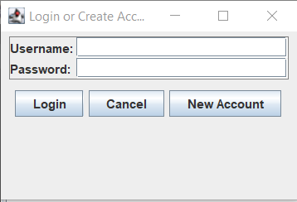
Creating an Account
In order to create an account, enter your selected username and password, then click new account. In order to login to your account in the future, use the login button. If you wish to continue without an account click cancel, however not all features will be usable.

Slide 3
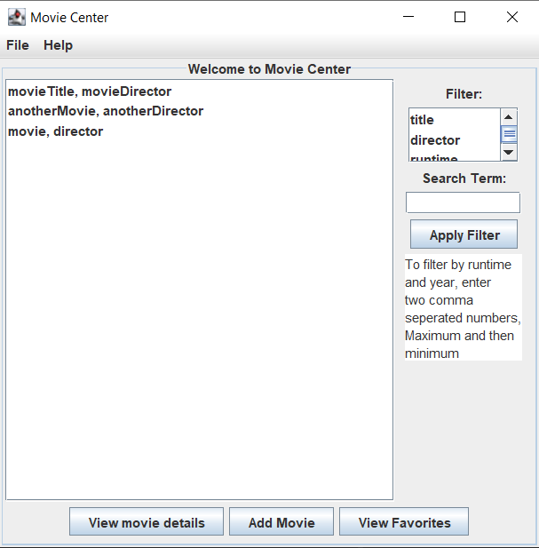
Landing Page
In order to filter the movie list, first select a criteria from the list of filters, than fill in the term to filter with in the box. Clicking apply filter will update the list.
This is the movie list, click on a movie to select it.
After selecting a movie, this button will open a new page with information about the selected movie
This button will open a new page displaying movies that you have favorited
If there is a movie you would like to be added, click this button to submit it

Slide 4
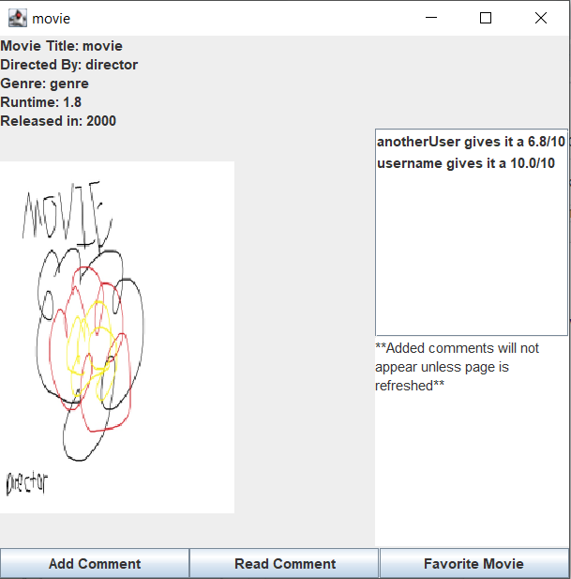
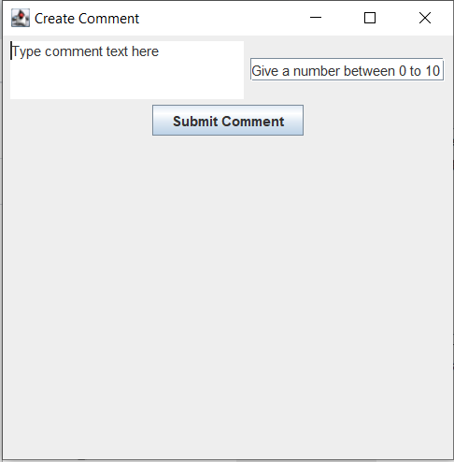
Movie Details Page
This is the create comment window. It has a box for the comment, a box for the rating, and a button which will add the comment.
This is the list of comments
These are the details about the movie, and movie poster
This is the text display for comments
This button favorites the movie. If the movie is favorited already it will be an unfavorite button
This button will open the new comment window(right).
After selecting a comment in the list, this button will show the text of the comment

Slide 5
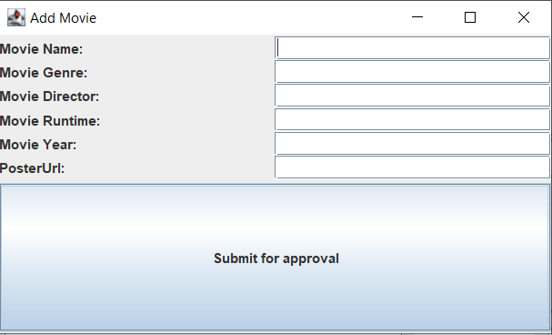
Add Movie
Fill in the movie’s details into these fields.
PosterUrl should be a link to an image of the movie’s poster
After filling in the details, click the submit button. An admin or moderator will review your submission and if it is valid will add it.

Slide 6
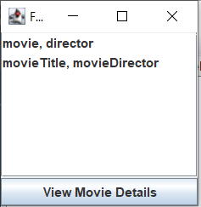
Favorite Movies
This button will open the movie details page for the selected movie
This is the list of your favorite movies. Click one to select it.

